Slide 1

Introduction to Deep Learning
Chunhui Xu
Ph.D. Student
The slides provided by Prof. Dong Xu

Slide 2
Topics
Introduction to Deep Neural Networks (DNN): (1) motivations for deep architectures; (2) input representations; (3) softmax; (4) maxout/ReLU; (5) dropout; (6) batch normalization.
Pre-training and Generative Models: (1) unsupervised pre-training; (2) Restricted Boltzmann Machines (RBM); (3) auto-encoders; (4) Variational Auto-Encoder (VAE); (5) Generative Adversarial Network (GAN).
Convolutional Neural Network (CNN): (1) concept of CNN; (2) convolution operation; (3) pooling; (4) residual network; (5) inception network; (6) network design.
Capsule Network: (1) concept; (2) CapsNet architecture; (3) dynamic routing.
Recurrent Neural Network (RNN): (1) structure of RNN; (2) Long Short-term Memory (LSTM); (3) attention mechanism; (4) Word2vec; (5) other deep learning language models.

Slide 3
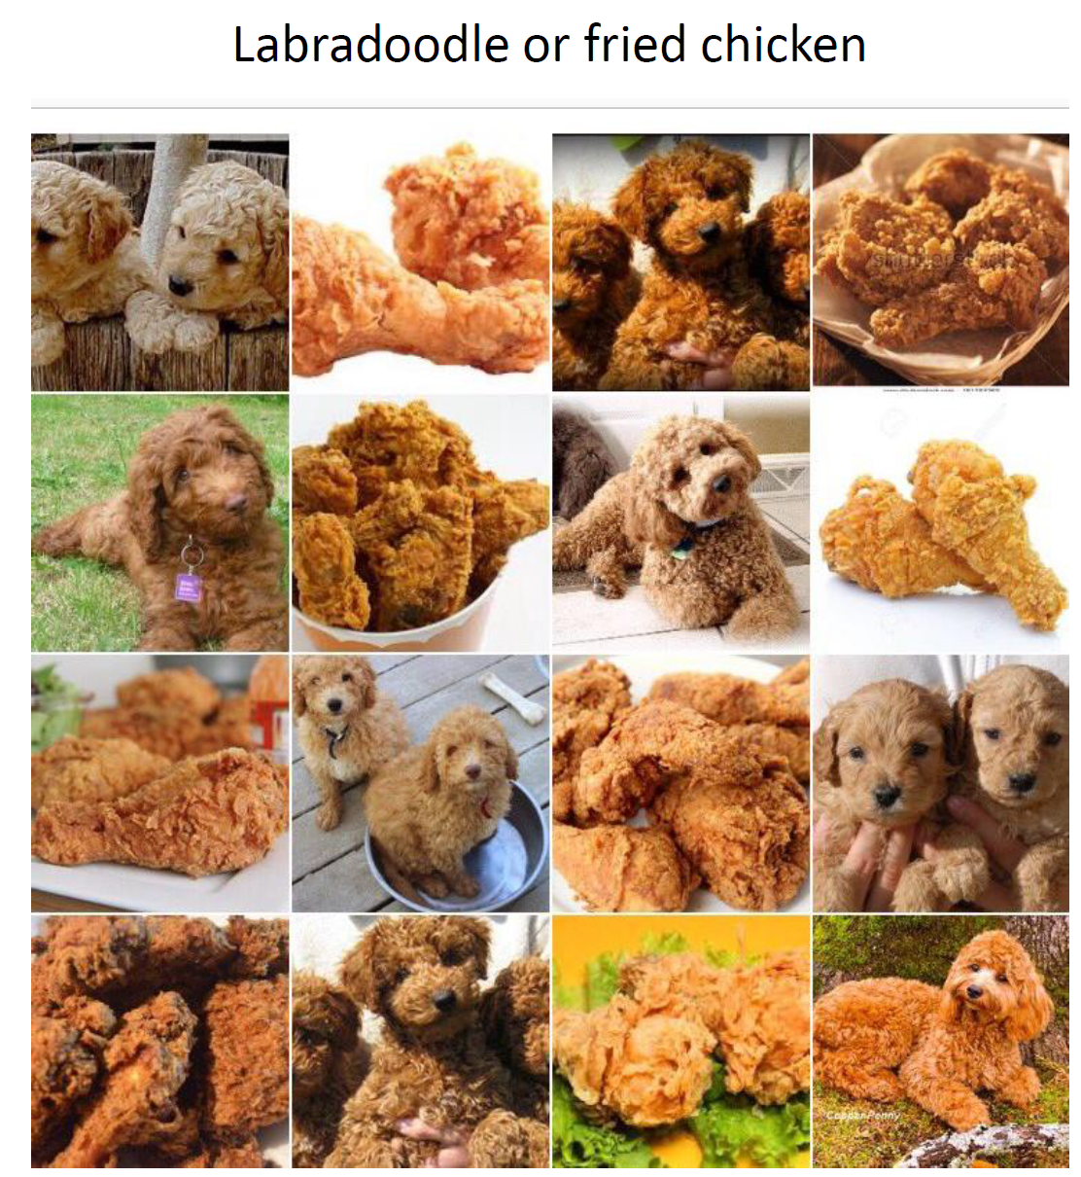

Slide 4
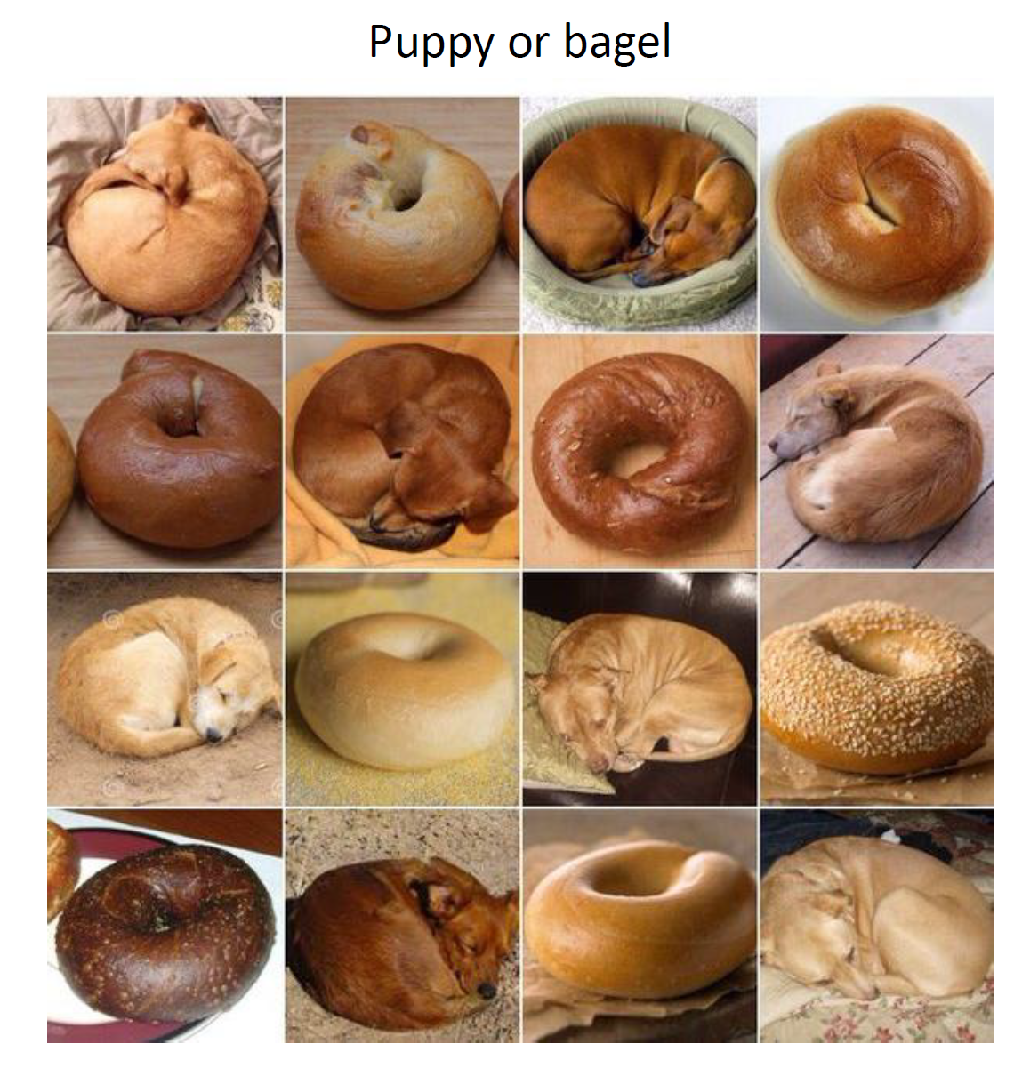

Slide 5
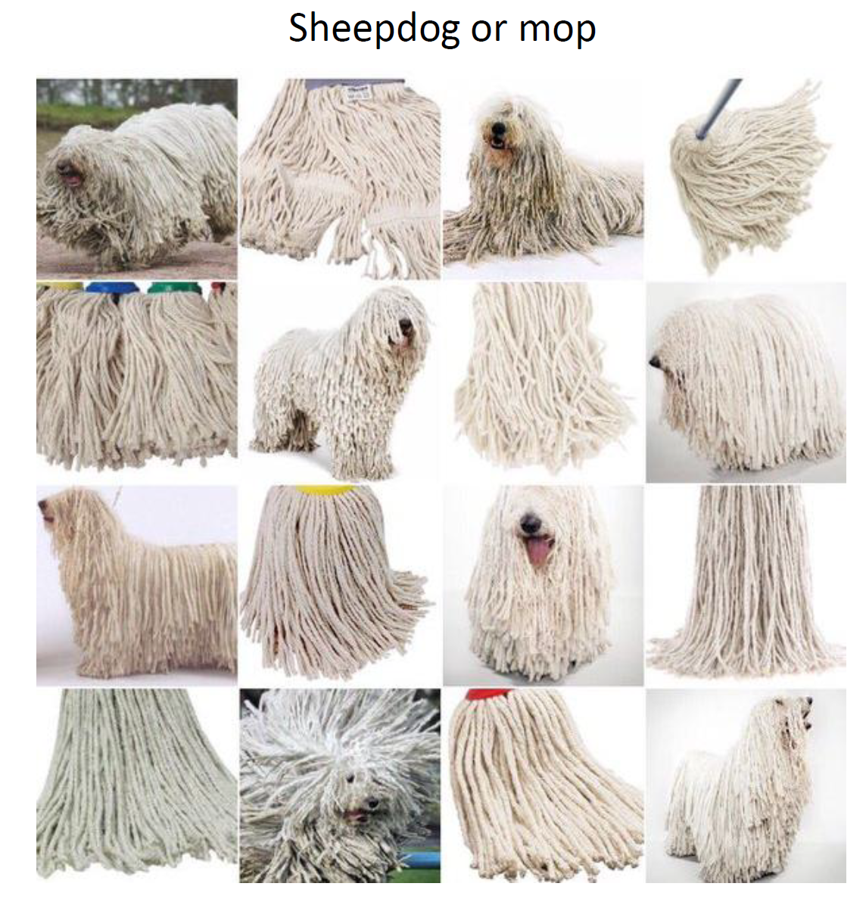

Slide 6
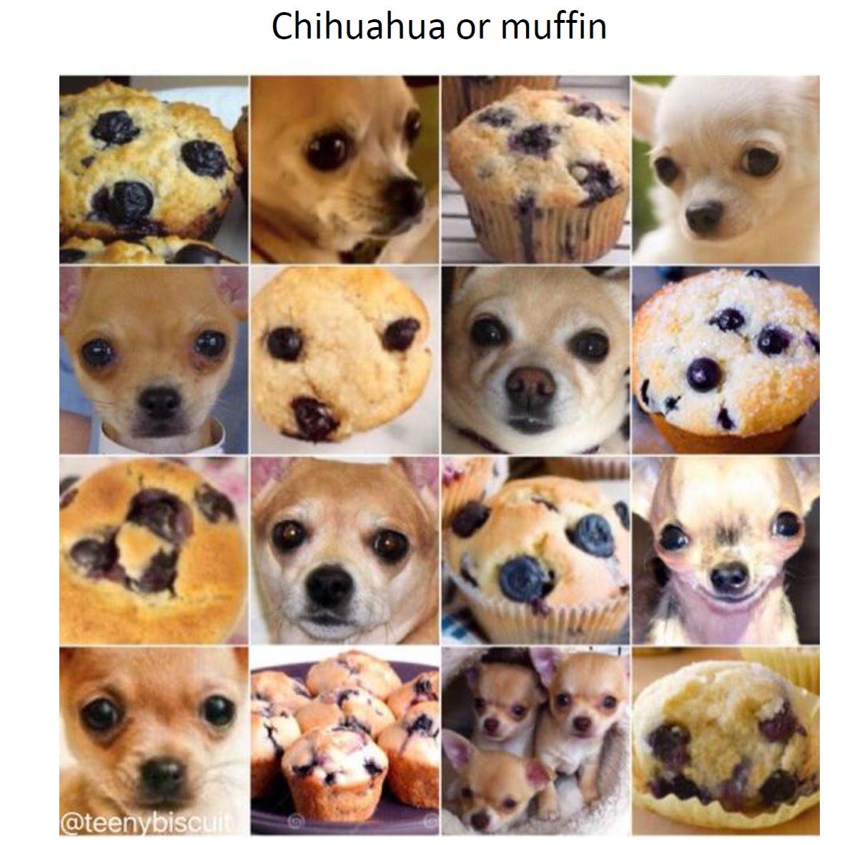

Slide 7
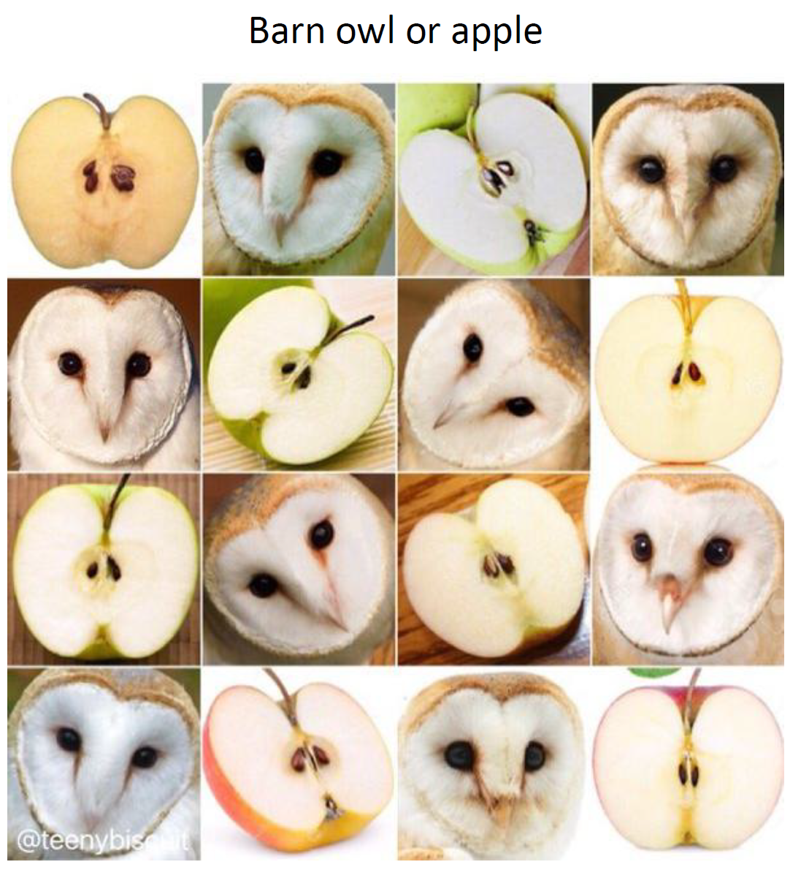

Slide 8
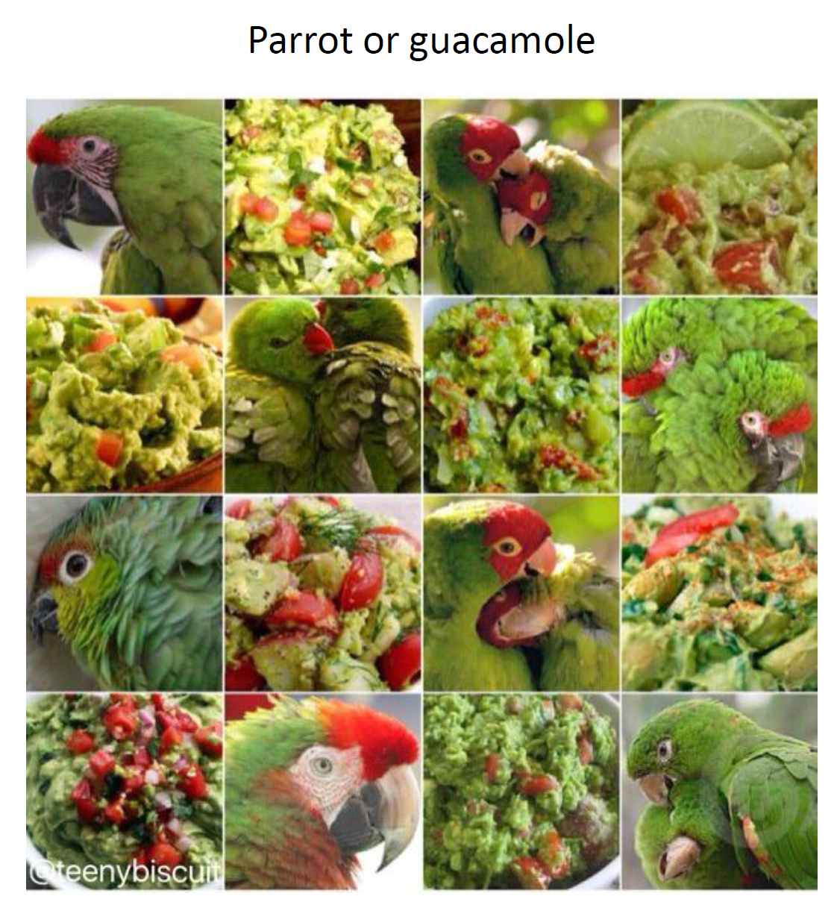

Slide 9
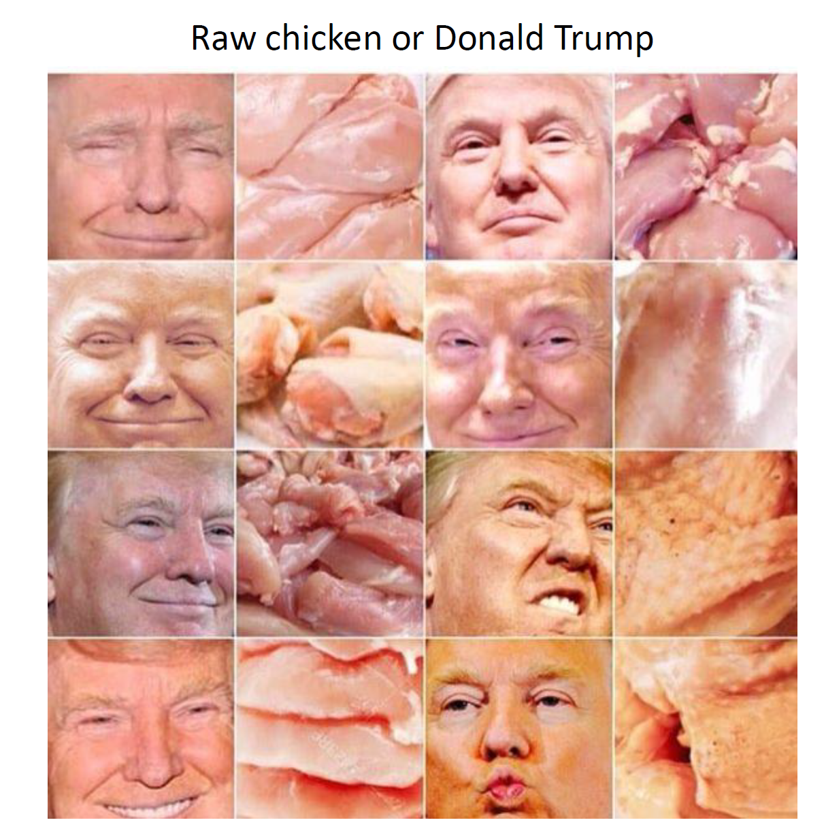

Slide 10
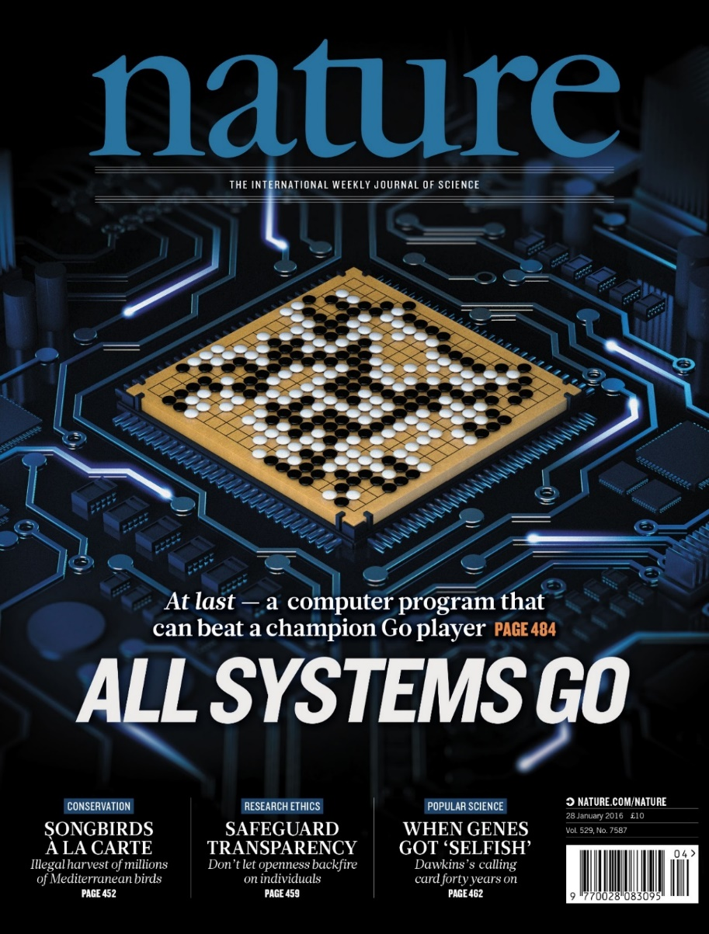
In “Nature” 27 January 2016:
“DeepMind’s program AlphaGo beat Fan Hui, the European Go champion, five times out of five in tournament conditions...”
“AlphaGo was not preprogrammed to play Go: rather, it learned using a general-purpose algorithm that allowed it to interpret the game’s patterns.”
“…AlphaGo program applied deep learning in neural networks (convolutional NN) — brain-inspired programs in which connections between layers of simulated neurons are strengthened through examples and experience.”

Slide 11
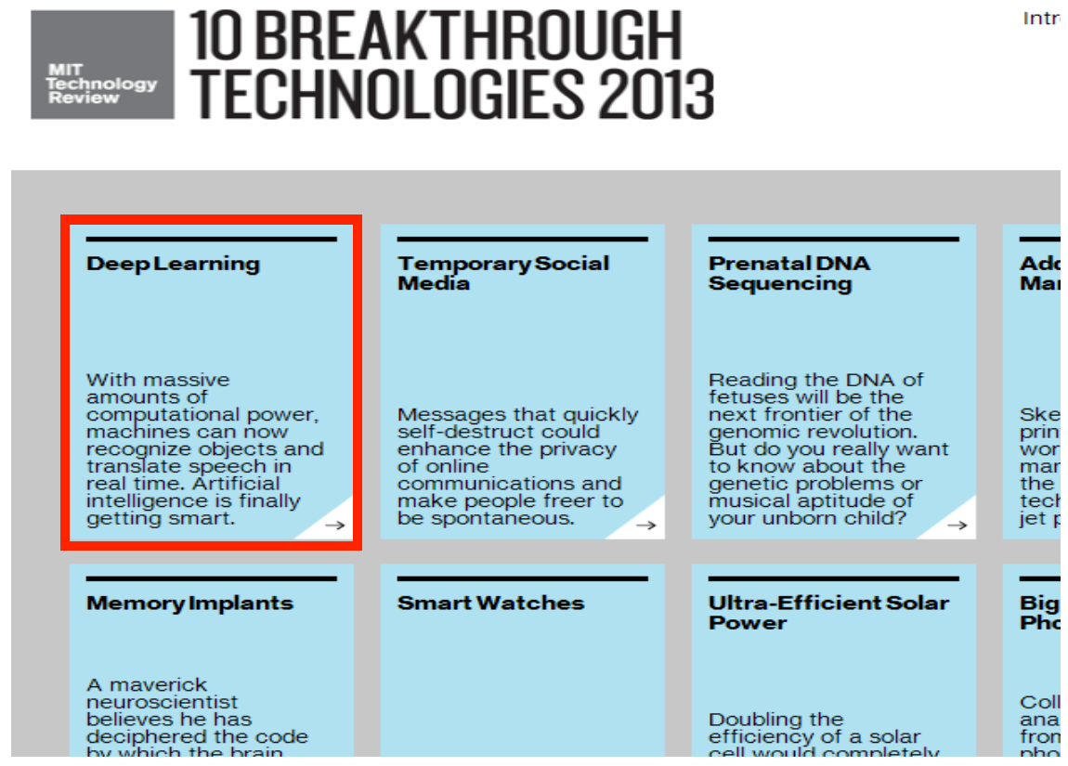

Slide 12
Foundation of Deep Learning
New data
New computer
New architecture

Slide 13
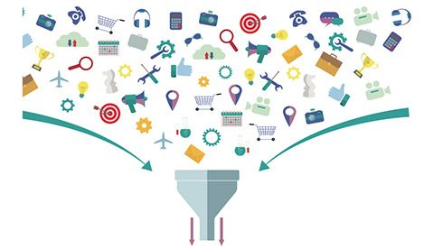
“Big data”

Slide 14
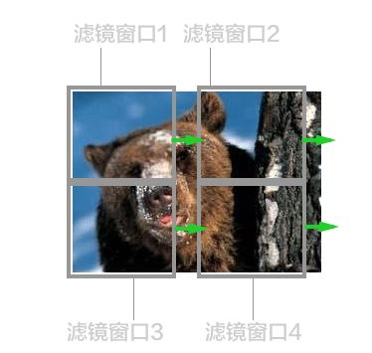
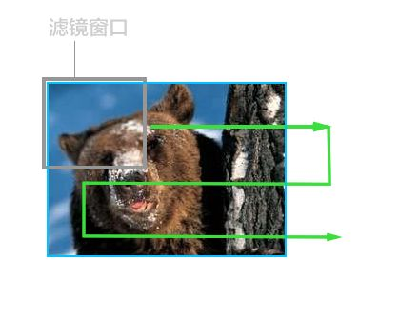
New computer
CPU
摩尔定律（英语：Moore's law）是由英特尔（Intel）创始人之一戈登·摩尔提出的。其内容为：集成电路上可容纳的晶体管数目，约每隔两年便会增加一倍；经常被引用的“18个月”，是由英特尔首席执行官大卫·豪斯（David House）提出：预计18个月会将芯片的性能提高一倍（即更多的晶体管使其更快），是一种以倍数增长的观测。
GPU

Slide 15
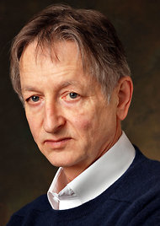
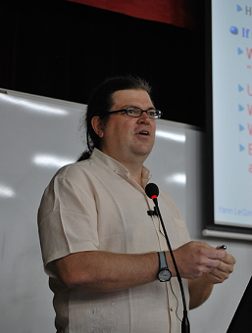
Hall of Fames in Deep Learning
Geoffery Hinton
(RBM, DNN, capsule)
Michael Jordan
(RNN)
Yoshua Bengio
(auto-encoder, GAN)
Yann LeCun
(CNN)
Ian Goodfellow
(GAN)

Slide 16
Deep learning in Artificial intelligence (AI)

Slide 17
Different approaches
Representation Learning
在机器学习中，特征学习或表征学习，是学习一个特征的技术的集合：将原始数据转换成为能够被机器学习来有效开发的一种形式。它避免了手动提取特征的麻烦，允许计算机学习使用特征的同时，也学习如何提取特征：学习如何学习。

Slide 18
Machine Learning Basics
Machine learning is a field of computer science that gives computers the ability to learn without being explicitly programmed
Labeled Data
Machine Learning algorithm
Training
Prediction
Labeled Data
Learned model
Prediction
Methods that can learn from and make predictions on data

Slide 19
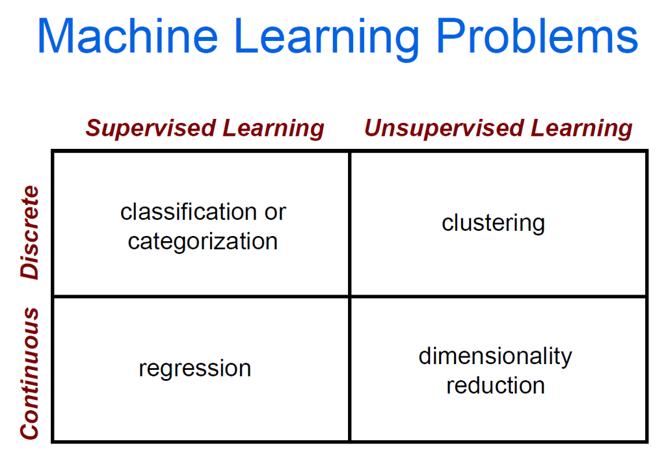

Slide 20
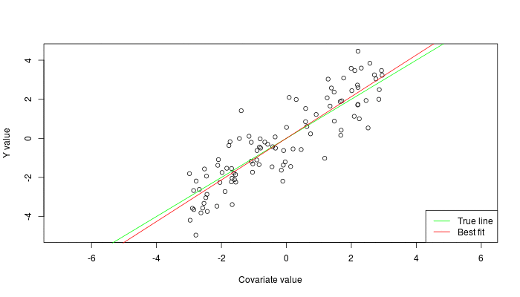


Types of Learning
Supervised: Learning with a labeled training set
Example: email classification with already labeled emails
Unsupervised: Discover patterns in unlabeled data
Example: cluster similar documents based on text
Reinforcement learning: learn to act based on feedback/reward
Example: learn to play Go, reward: win or lose
class A
class A
Classification
Regression
Clustering
Anomaly Detection
Sequence labeling
…
http://mbjoseph.github.io/2013/11/27/measure.html

Slide 21
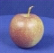
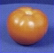
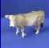
Supervised Machine learning
Apply a prediction function to a feature representation of the image to get the desired output:
f( ) = “apple”
f( ) = “tomato”
f( ) = “cow”

Slide 22

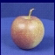
Steps
Training
Training Labels
Training Images
Image Features
Training
Learned model
Testing
Image Features
Learned model
Prediction
Test Image

Slide 23
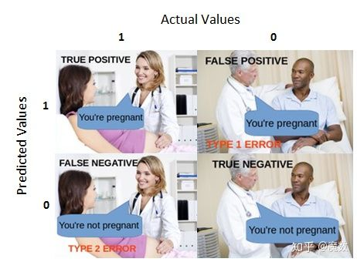
Machine Learning Evaluation

Slide 24
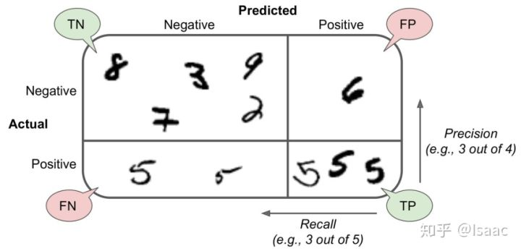
Confusion Matrix – 混淆矩阵

Slide 25
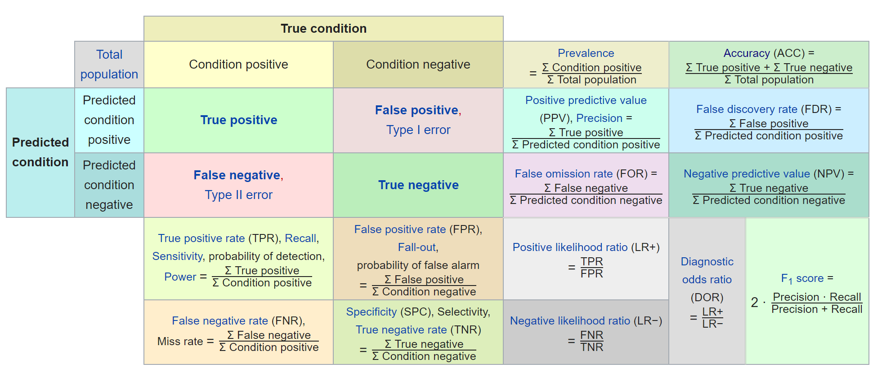

Slide 26

What is Deep Learning (DL) ?
A machine learning subfield of learning representations of data. Exceptional effective at learning patterns.
Deep learning algorithms attempt to learn (multiple levels of) representation by using a hierarchy of multiple layers
If you provide the system tons of information, it begins to understand it and respond in useful ways.
https://www.xenonstack.com/blog/static/public/uploads/media/machine-learning-vs-deep-learning.png

Slide 27
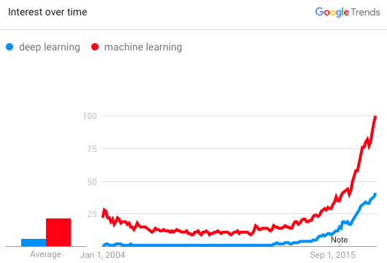
Why is DL useful?
Manually designed features are often over-specified, incomplete and take a long time to design and validate
Learned Features are easy to adapt, fast to learn
Deep learning provides a very flexible, (almost?) universal, learnable framework for representing world, visual and linguistic information.
Can learn both unsupervised and supervised
Effective end-to-end joint system learning
Utilize large amounts of training data
In ~2010 DL started outperforming other ML techniques
first in speech and vision, then NLP

Slide 28
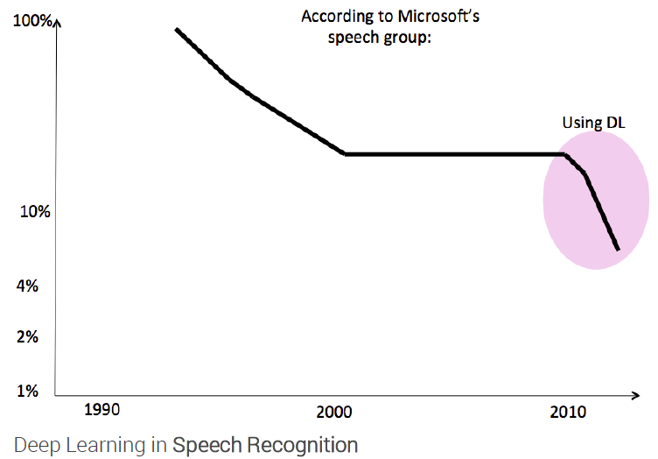
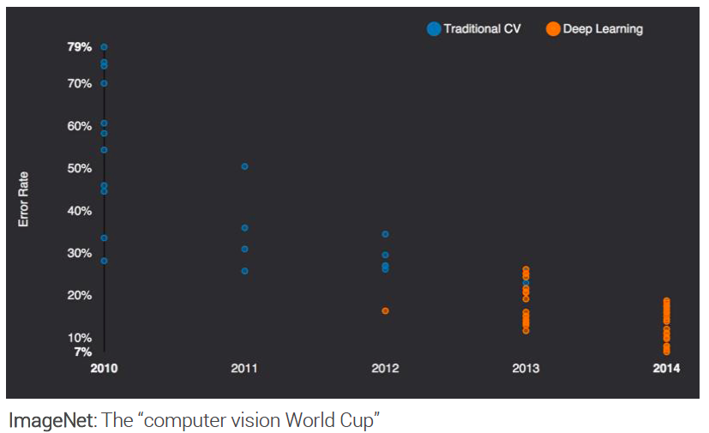
State of the art in …
Several big improvements in recent years in NLP
Machine Translation
Sentiment Analysis
Dialogue Agents
Question Answering
Text Classification …
Leverage different levels of representation
words & characters
syntax & semantics

Slide 29
Deeper is Better?
Layer X Size | Word Error Rate (%) | Layer X Size | Word Error Rate (%)
1 X 2k | 24.2
2 X 2k | 20.4
3 X 2k | 18.4
4 X 2k | 17.8
5 X 2k | 17.2 | 1 X 3772 | 22.5
7 X 2k | 17.1 | 1 X 4634 | 22.6
 |  | 1 X 16k | 22.1
Not surprised, more parameters, better performance
Seide et al. Interspeech. 2011.
Notes:
SWB
For a fixed number of parameters, a deep model is clearly better than the shallow one.

Slide 30
Why “Deep” neural network not “Fat” neural network?
The same number of parameters
……
……
……
Shallow
Deep

Slide 31
Fat + Short v.s. Thin + Tall
Layer X Size | Word Error Rate (%) | Layer X Size | Word Error Rate (%)
1 X 2k | 24.2
2 X 2k | 20.4
3 X 2k | 18.4
4 X 2k | 17.8
5 X 2k | 17.2 | 1 X 3772 | 22.5
7 X 2k | 17.1 | 1 X 4634 | 22.6
 |  | 1 X 16k | 22.1
Seide et al. Interspeech. 2011.

Slide 32
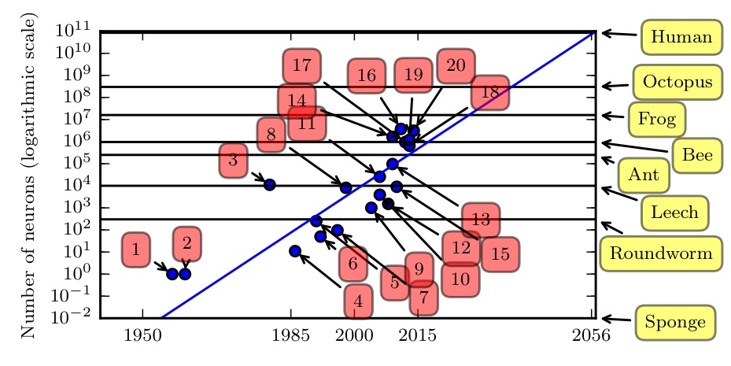
Number of Neurons

Slide 33
Why No Deep Network Before?
Lack of data
Lack of computing power
Lack of good network architectures

Slide 34
Depth: Repeated Composition

Slide 35

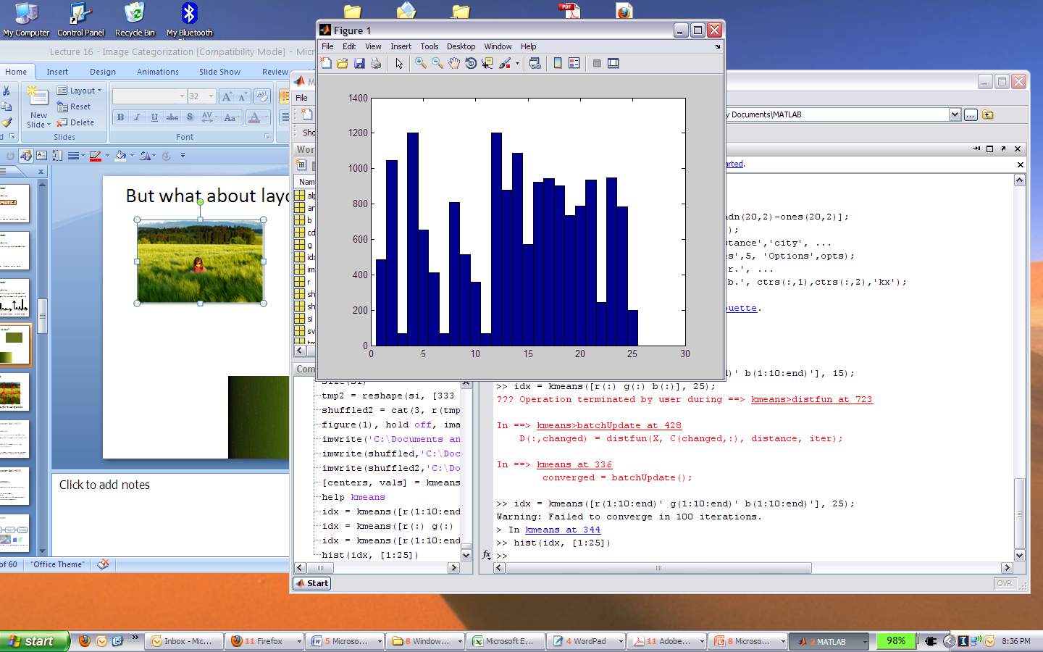
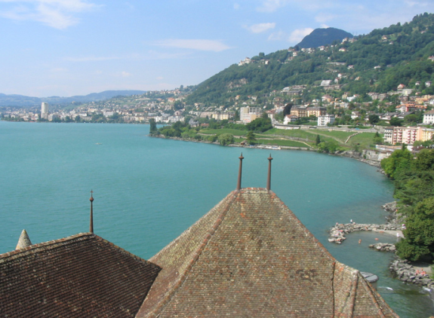
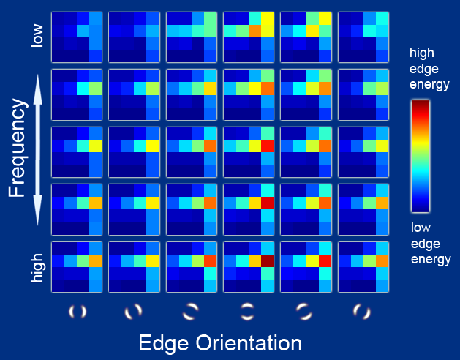
Features
Raw pixels
像素
Histograms
当我们用横轴代表0-255,
的亮度数值。竖轴代表照
片中对应亮度的像素数量，
这个函数图像就被称为直方图。
GIST descriptors
Geometric ratios

Slide 36

Input Features
Traditional pattern recognition models use hand-crafted features and relatively simple trainable classifier.
hand-crafted feature extractor
“simple” trainable classifier
output

Slide 37
Input Features
Hand-crafted features have the following limitations:
Tedious and costly to develop 繁琐且开发成本高
May be biased and incomplete
可能有偏见和不完整
Usually highly dependents on one application, and cannot be transferred easily to other applications
转移性差

Slide 38

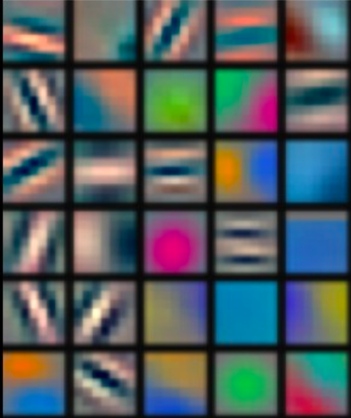
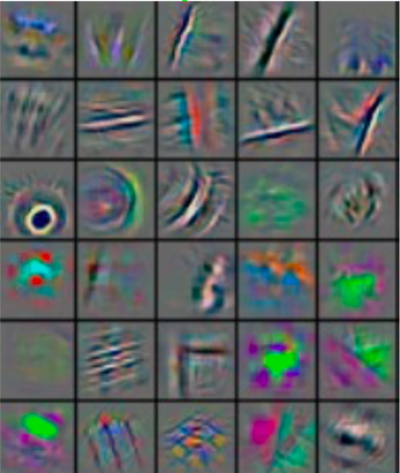
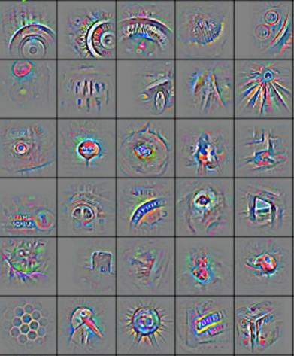
Learning Hierarchical Representations
Deep learning (representation learning) seeks to learn rich hierarchical representations (i.e. features) automatically through multiple stage of feature learning process.
深度学习（表示学习）试图通过特征学习过程的多个阶段自动学习丰富的层次表示（即特征）。
Low-level features
Mid-level features
High-level features
Trainable classifier
output
(Zeiler and Fergus, 2013)

Slide 39
Learning Hierarchical Representations
Low-level features
Mid-level features
High-level features
Trainable classifier
output
Increasing level of abstraction
Hierarchy of representations with increasing level of abstraction. Each stage is a kind of trainable nonlinear feature transform
具有越来越高的抽象水平的表示层次。每个阶段都是一种可训练的非线性特征变换
Image recognition
Pixel → edge → texton → motif → part → object
Text
Character → word → word group → clause → sentence → story
Notes:
The word ‘deep’ in deep learning refers to the layered model architectures which are usually deeper than conventional learning models.

Slide 40
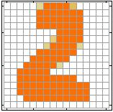
Example Application
Handwriting Digit Recognition
Machine
“2”
Notes:
“Hello world” for deep learning
Data: http://yann.lecun.com/exdb/mnist/

Slide 41
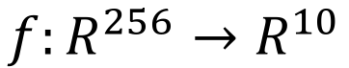
Example Application
Handwriting Digit Recognition
y₁
Machine
y₂
“2”
……
……
y₁₀
$$f:R^{256}→R^{10}$$

Slide 42
Handwriting Digit Recognition
Input
Output
y₁
is 1
0.1
y₂
is 2
0.7
The image is “2”
……
……
……
y₁₀
0.2
is 0
16 x 16 = 256
Ink → 1
No ink → 0
Each dimension represents the confidence of a digit.
Notes:
The same for even more complex tasks.

Slide 43
Handwriting Digit Recognition
MNIST
Kaggle
MNIST（“国家标准技术研究院”）是计算机视觉的事实上的“ hello world”数据集。自从1999年发布以来，这个经典的手写图像数据集就成为基准分类算法的基础。随着新的机器学习技术的出现，MNIST仍然是研究人员和学习者的可靠资源。
Kaggle是一个数据建模和数据分析竞赛平台。企业和研究者可在其上发布数据，统计学者和数据挖掘专家可在其上进行竞赛以产生最好的模型。
Kaggle提供了无需安装,可定制,Jupyter笔记本电脑环境

Slide 44

MNIST

Slide 45
Deep Neural Network (DNN)
neuron
Input
Layer 1
Layer 2
Layer L
Output
……
y₁
……
y₂
……
……
……
……
……
……
y_{M}
Input Layer
Output Layer
Hidden Layers
Deep means many hidden layers
Notes:
Fully Connected Feedforward Network
You can always connect the neurons in your own way.
“+” is ignored
Each dimension corresponds to a digit (10 dimension is needed)

Slide 46
Why DNN Works
Manifold: a continuous collection of sample points
连续的采样点集合
DNN layers’ landscape models the low dimensional manifolds of the input samples
Many functions that can be represented efficiently with a deep architecture!
许多方程可以用一个深度架构有效地表示
Often more powerful than statistical methods and traditional machine learning methods
通常比统计方法和传统的机器学习方法更强大
Notes:
“Hello world” for deep learning
Data: http://yann.lecun.com/exdb/mnist/

Slide 47

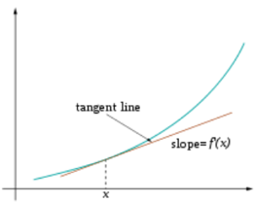
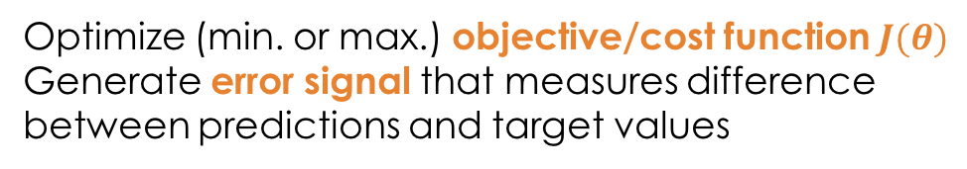
Training
Sample labeled data
(batch)
Forward it through the network, get predictions
Back-propagate the errors
Update the network weights
Optimize (min. or max.) objective/cost function $J(θ)$
Generate error signal that measures difference between predictions and target values
Use error signal to change the weights and get more accurate predictions
Subtracting a fraction of the gradient moves you towards the (local) minimum of the cost function
https://medium.com/@ramrajchandradevan/the-evolution-of-gradient-descend-optimization-algorithm-4106a6702d39

Slide 48
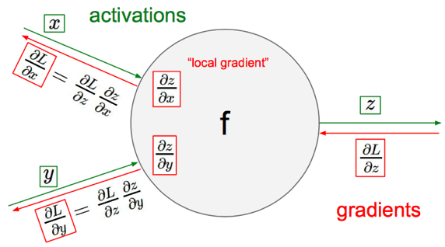
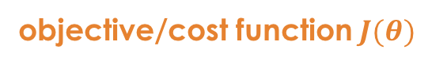
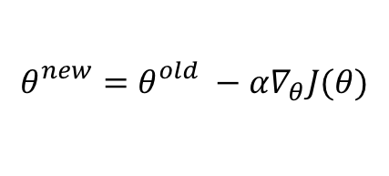
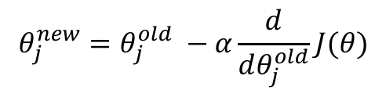
Gradient Descent
objective/cost function $J(θ)$
Review of backpropagation
$$θ_{j}^{new}=θ_{j}^{old} −α\frac{ⅆ}{ⅆθ_{j}^{old}}J(θ)$$
Update each element of θ
$$θ_{}^{new}=θ_{}^{old} −α∇_{θ}J(θ)$$
Matrix notation for all parameters
learning rate
Recursively apply chain rule though each node
Notes:
Adaptive Gradient Algorithm (AdaGrad) that maintains a per-parameter learning rate that improves performance on problems with sparse gradients (e.g. natural language and computer vision problems).
Root Mean Square Propagation (RMSProp) that also maintains per-parameter learning rates that are adapted based on the average of recent magnitudes of the gradients for the weight (e.g. how quickly it is changing). This means the algorithm does well on online and non-stationary problems (e.g. noisy).
Adam realizes the benefits of both AdaGrad and RMSProp.
Instead of adapting the parameter learning rates based on the average first moment (the mean) as in RMSProp, Adam also makes use of the average of the second moments of the gradients (the uncentered variance).
Specifically, the algorithm calculates an exponential moving average of the gradient and the squared gradient, and the parameters beta1 and beta2 control the decay rates of these moving averages.
The initial value of the moving averages and beta1 and beta2 values close to 1.0 (recommended) result in a bias of moment estimates towards zero. This bias is overcome by first calculating the biased estimates before then calculating bias-corrected estimates.

Slide 49
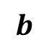

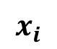
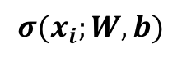
One forward pass
Text (input) representation
TFIDF
Word embeddings
….
0.2 | -0.5 | 0.1
2.0 | 1.5 | 1.3
0.5 | 0.0 | 0.25
-0.3 | 2.0 | 0.0
0.1
0.2
0.3
1.0
3.0
0.025
0.0
0.95
3.89
0.15
0.37
very positive
positive
negative
very negative
$$W$$
$$x_{i}$$
$$b$$
$$σ(x_{i};W, b)$$

Slide 50
Softmax
Softmax layer as the output layer
Ordinary Layer
In general, the output of network can be any value.
May not be easy to interpret
Notes:
Original output layer is local

Slide 51
Softmax Advantages
Softmax (softens) 1 of n targets to mimic a probability vector for each output.
Each value ranges between 0 and 1. The sum of all values is always 1.
Output is linearly separable
Notes:
Cross entropy with sigmoid also has t-z gradient as ln undoes exponential of sigmoid.
Softmax with TSS gives gradient of (t-z)z(d-z of target node) where d is of 1 if node is target, else 0, saturates and global
CE loss – 0 for non target nodes, and ln(z) for target node. Thus if z = 1 0, loss, loss grows as z approaches 0

Slide 52
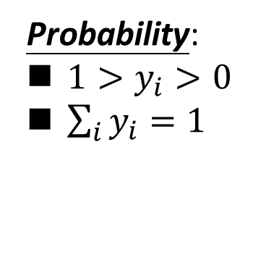
Softmax
Probability:
$1>y_{i}>0$
$\sum_{i}{y_{i}=1}$
Softmax layer as the output layer
Softmax Layer
3
20
0.88
1
2.7
0.12
-3
0.05
≈0
Notes:
Why it is name soft max?
Monotonicity of softmax
Non-locality of softmax
当输入为X时，预测为猫的概率是预测不是猫的概率的3倍

Slide 53

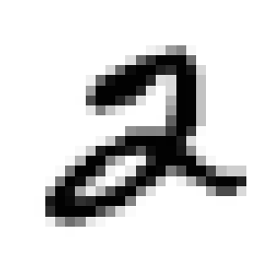
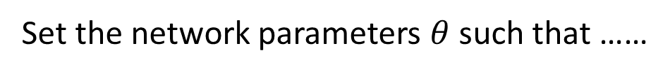
How to set network parameters
$$θ=\left\{W^{1},b^{1},W^{2},b^{2},⋯W^{L},b^{L}\right\}$$
……
y₁
is 1
0.1
……
y₂
0.7
is 2
Softmax
……
……
……
……
y₁₀
is 0
0.2
16 x 16 = 256
Set the network parameters $θ$ such that ……
Ink → 1
No ink → 0
Input:
y₁ has the maximum value
Input:
y₂ has the maximum value

Slide 54
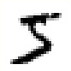

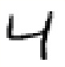
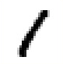




Training Data
Preparing training data: images and their labels
“5”
“0”
“4”
“1”
“9”
“2”
“1”
“3”
Using the training data to find the network parameters.

Slide 55



Cost
Given a set of network parameters $θ$, each example has a cost value.
“1”
……
y₁
0.2
1
……
y₂
0
0.1
……
……
……
Cost
……
……
……
y₁₀
$$L(θ)$$
0
0.5
target
Cost can be Euclidean distance or cross entropy of the network output and target
$$C\left(θ\right)=\sum_{r=1}^{R}{L^{r}\left(θ\right)}$$
Notes:
With softmax, the summation of all the ouputs would be one.
Can be considered as probability if you want ……

Slide 56
Early Stop

Slide 57
Playground tensorflow

Slide 58












Vanishing Gradient Problem 梯度消失问题
Smaller gradients
……
$$y_{1}$$
$${\hat{y}}_{1}$$
Small output
……
$$y_{2}$$
$${\hat{y}}_{2}$$
……
……
……
……
……
$$C$$
……
$$+∆C$$
……
$$y_{M}$$
$${\hat{y}}_{M}$$
Large input
$$+∆w$$
Intuitive way to compute the gradient …
$$\frac{∂C}{∂w}=?$$
$$\frac{∆C}{∆w}$$

Slide 59




Rectified Linear Units (ReLU)
0
0
0
$$a$$
$$a=z$$
0
$$a=0$$
$$z$$

Slide 60
ReLU Advantages
More efficient gradient propagation, derivative is 0 or constant, just fold into learning rate
梯度传播更有效，导数为0或恒定，仅折合成学习率
More efficient computation: Only comparison, addition and multiplication.
更有效的计算：比较，加法和乘法。
Sparse activation: For example, in a randomly initialized networks, only about 50% of hidden units are activated (having a non-zero output)
稀疏激活：例如，在随机初始化的网络中，只有大约50％的隐藏单元被激活（输出为非零）
Learning in linear range easier for most learning models 对于大多数学习模型而言，在线性范围内学习更容易
Notes:
Green is softplus function f(x) = ls(1+e^x) (smooth version of RLU), whose derivative is the sigmoid 1/(1+e^-x)
For regular ReLU, set bias slightly positive, so that active to start with
Leaky ReLU f(x) = x if > 0 else .01x – some effect for x < 0
Note ReLU is not everywhere differentiable. At 0 just choose left or right derivative (0 or 1) and works fine empirically, though theoretically a bit bothersome – Note that since net is real number the prob(0) = 0 anyways and if computer has 0, probably just a representation issue and we would be a little to the left or right anyways in a true system.
So why not same with threshold function? Derivate would be 0 everywhere with no learning
Principle: Nets easier to optimize when there behavior is closer to linear
Still learning why ReLUs work as well as they do

Slide 61












Maxout
ReLU is a special cases of Maxout
Learnable activation function [Ian J. Goodfellow, ICML’13]
+
neuron
+
$$5$$
$$1$$
Input
Max
$$7$$
Max
$$2$$
+
$$7$$
+
$$2$$
+
$$−1$$
+
$$4$$
Max
$$1$$
Max
$$4$$
+
$$1$$
+
$$3$$
You can have more than 2 elements in a group.
Notes:
How to train? Latter
2013
Ian J. Goodfellow goodfeli@iro.umontreal.ca David Warde-Farley wardefar@iro.umontreal.ca Mehdi Mirza mirzamom@iro.umontreal.ca Aaron Courville aaron.courville@umontreal.ca Yoshua Bengio

Slide 62
Maxout
Learnable activation function [Ian J. Goodfellow, ICML’13]
Activation function in maxout network can be any piecewise linear convex function maxout网络中的激活函数可以是任何分段线性凸函数
How many pieces depending on how many elements in a group 多少件取决于一组中的多少个元素
2 elements in a group
3 elements in a group
Notes:
3,4,5

Slide 63



















Maxout
+
$$z_{1}^{}$$
$$z$$
ReLU
Input
$$w$$
$$a$$
Input
$$w$$
Max
$$b$$
$$a$$
$$0$$
+
$$z_{2}^{}$$
$$max\left\{z_{1}^{},z_{2}^{}\right\}$$
$$b$$
$$0$$
$$a$$
$$a$$
$$z=wx+b$$
$$z_{1}=wx+b$$
$$x$$
$$x$$
$z_{2}=$0

Slide 64



Maxout
+
$$z_{1}^{}$$
$$z$$
ReLU
Input
$$w$$
$$a$$
Input
$$w$$
Max
$$b$$
$$a$$
+
$$z_{2}^{}$$
$$w^{′}$$
$$max\left\{z_{1}^{},z_{2}^{}\right\}$$
$$b$$
$$b^{′}$$
Learnable Activation Function
$$a$$
$$a$$
$$z=wx+b$$
$$z_{1}=wx+b$$
$$x$$
$$x$$
$$z_{2}=w^{′}x+b^{′}$$

Slide 65
Dropout
Prevent from over-fitting
Prevent units from co-adapting
Training: remove randomly selected units according to a rate (0.4)
Testing: multiply all the units with (1- dropout rate)

Slide 66

Testing:
No dropout
If the dropout rate at training is p%, all the weights times (100-p)%
Assume that the dropout rate is 40%.
If a weight $w=1$ by training, set $w=0.6$for testing.
Notes:
Bias do not have to multiply !!!!!!!!!!!!!!!!!!!!!!!!!!!!!!!!!!!
Reasonable !!!!!!!!!!!!!!!!!!!!

Slide 67
















Dropout - Intuitive Reason
Why the weights should multiply (100-p)% (dropout rate) when testing?
Training of Dropout
Testing of Dropout
Assume dropout rate is 50%
No dropout
Weights from training
$$w_{1}$$
$$0.5×$$
$$w_{1}$$
$$z^{′}≈2z$$
$$w_{2}$$
$$z$$
$$0.5×$$
$$w_{2}$$
$$z^{′}$$
$$w_{3}$$
$$0.5×$$
$$w_{3}$$
$$w_{4}$$
$$0.5×$$
$$w_{4}$$
Weights multiply (1-p)%
$$z^{′}≈z$$
Notes:
important

Slide 68
Dropout is an ensemble
Training Set
Ensemble
Set 1
Set 2
Set 3
Set 4
Network
1
Network
2
Network
3
Network
4
Train a bunch of networks with different structures

Slide 69
Dropout is an ensemble
Ensemble
Testing data x
Network
1
Network
2
Network
3
Network
4
y₁
y₂
y₃
y₄
average

Slide 70
Dropout is an ensemble
Training of Dropout
minibatch
1
minibatch
2
minibatch
3
minibatch
4
M neurons
……
2^{M} possible networks
Using one mini-batch to train one network
Some parameters in the network are shared

Slide 71
Dropout is an ensemble
Testing of Dropout
testing data x
All the weights multiply (100-p)%
……
y₁
y₂
y₃
average
≈
y
Notes:
0,0 -> 0
1,0 -> 1
0,-1 -> -2
1,-1 -> -1
½, -1/2 -> -0.5
1,2
Geometric Mean?

Slide 72
Mini-batch

Slide 73

Batch normalization

Slide 75







Feature Scaling
Make different features have the same scaling
w₁
w₂
w₁
w₂
1, 2 ……
x₁

a
1, 2 ……
x₁

a
100, 200 …… x₂
b
1, 2 ……
x₂
b
w₂
Loss L
w₂
Loss L
w₁
w₁

Slide 76
Feature Scaling
In general, gradient descent converges much faster
with feature scaling than without it.

Slide 77
How about Hidden Layer?

Slide 78
Batches

Slide 79
Batch normalization

Slide 80
Batch normalization

Slide 81
Batch normalization

Slide 82
Test stage
We do not have batch at testing stage. Ideal solution:
Computing 𝜇 and 𝜎 using the whole
training dataset.
Practical solution:
Computing the moving average of 𝜇 and 𝜎 of the batches during training.

Slide 83
Benefits
BN reduces training times, and make very deep net
trainable.
Because of less Covariate Shift, we can use larger learning rates.
Less exploding/vanishing gradients
Especially effective for sigmoid, tanh, etc.
Learning is less affected by initialization.
BN reduces the demand for regularization.

Slide 84
Summary
Deep networks address limitation of traditional neural networks
Representation learning: from low-level features directly
Softmax mimics output distribution function
ReLU/maxout provides more efficient gradient propagation
Dropout reduces over-training
Batch normalization is more trainable

Slide 85
Further Reading
http://sanghv.com/download/soft/machine%20learning,%20artificial%20intelligence,%20mathematics%20ebooks/ML/learning%20deep%20architectures%20for%20AI%20(2009).pdf
http://www.biorxiv.org/content/early/2015/10/26/029876
https://arxiv.org/abs/1506.08700
https://github.com/Kulbear/deep-learning-nano-foundation/wiki/ReLU-and-Softmax-Activation-Functions
http://proceedings.mlr.press/v28/goodfellow13.pdf
https://www.cs.toronto.edu/~hinton/absps/NatureDeepReview.pdf

Slide 86
Acknowledgments
This file is for the educational purpose only. Some materials (including pictures and text) were taken from the Internet at the public domain.

